Slide 1

Course Worksheets

Slide 2
CI Related to Essential Secrets
Essential Secrets | Critical Information (CI)
Location
Timing
Strength
Capability
Readiness
Intent
Method
Presence
Projected Lat / Long, Fleet AOR, Specific country area, Planned Intended Movements (PIM)
Deployment / Return dates, schedule of events
Additional units, personnel, resources not already published in PAI
Tech specs of new or updated equipment, addition not normally associated with unit
Level of preparedness to execute when required
Rehearsals, Security posture, Weapons posture, ROE, new TTP
How an objective will be achieved and what your unit offers to the mission objective
Where your unit is located now

Slide 3
Identify Value & Indicators
Essential Secret | Critical Information | Value | Indicator
Location
Timing
Strength
Capability
Readiness
Intent
Method
Presence
Projected Lat / Long, Fleet AOR, Specific country area, PIM
H
Social Media post of future potential port visit within a specified AOR
Deployment / Return dates, schedule of events
Ships heading to weapons station Command members at the airport with sea bags and equipment
M
Additional units, personnel, resources not already published in PAI
Additional Carrier Strike Group (CSG) and / or Expeditionary Strike Group (ESG) deployed to an AOR.
ML
Tech specs of new or updated equipment, addition not normally associated with unit
TECREPS visit command with company logos displayed. Install teams arrive at command
H
Level of preparedness to execute when required
M
News report of 25% of crew contracted COVID
Rehearsals, Security posture, Weapons posture, ROE, new TTP
ML
War games, specific commands / equipment arriving at a staging area
How an objective will be achieved and what your unit offers to the mission objective
Active monitoring of hostile A/C, move to staging area
M
Where your unit is located now
M
Electronic signature, lack of noise discipline

Slide 4


USN Systems Support Command
Identify Essential Secrets
Friendly Perspective
Adversary Perspective
Presence
Capability
Strength
Intent
Readiness
Timing
Location
Methods
Presence
Capability
Strength
Intent
Readiness
Timing
Location
Methods

Slide 5
USN Systems Support Command
Identify Critical Information
Critical Information – Friendly Perspective
Essential Secrets | Critical Information (CI)
Capabilities
Systems / equipment specifics
Readiness
Inventory available for deployment
Readiness / Strength
# of qualified teams available
Critical Information – Adversary Perspective
Essential Secrets | Critical Information (CI)
Capabilities
Systems / equipment specifics
Readiness
Inventory available for deployment
Readiness / Strength
# of qualified teams available
Timing / Readiness
Average time to arrive @ location
Average time to complete Install
Location
Location of systems installations

Slide 6
USN Systems Support Command
Value of Critical Information & Indicators
Essential Secret | Critical Information | Value | Indicator | Amplifying Data
Capabilities | Systems / equipment specifics / of platform installed on |  | Contracts
Readiness | Inventory available for deployment |  | Equipment movement from warehouse
Readiness / Strength | # of qualified teams available |  | Sailors leaving/traveling/arriving w/equipment | Inventory available for deployment aggregated w/ this CI raises value to H
Timing / Readiness | Average time to arrive @ location Average time to complete Install |  | Installation team departs Sailors leaving/traveling/arriving with out equipment | # of qualified teams available aggregated w/ this CI raises value to H
Location | Location of systems installation |  | Travel arrangements (flights, hotels, etc.)
H
MH
M
MH
H

Slide 7
Threat Analysis
Mission:
Adversary: |  | Collection Capabilities | Overall Assessment
Intent: |  | Level (H / MH / M / ML / L) | Level (H / MH / M / ML / L)
 | OSINT
 | HUMIT
 | SIGINT
 | GEOINT
 | MASINT
Install and maintain sensitive Fleet Systems and train Sailors on its operations
FIE
Probability adversary will act against us (Circle one)
HIGH
MEDIUM HIGH
MEDIUM
MEDIUM LOW
LOW
HIGH
HIGH
HIGH
HIGH
HIGH
HIGH
HIGH
HIGH
MEDIUM
MEDIUM HIGH

Slide 8
USN Systems Support Command
Vulnerability | Collection Method
Lack of awareness / apathy
OSINT / HUMINT / SIGINT / GEOINT
Unsecure comms
SIGINT
Social media / App use
OSINT
Overwhelmed QD / Piggybacking
HUMINT
Predictable patterns
OSINT / SIGINT / HUMINT / GEOINT
Alarm System
SIGINT / HUMINT

Slide 9
USN Systems Support Command
Vulnerability | Threat | Threat Rating | Critical Information | Value / Impact | Risk | CM | Residual Risk
Lack of awareness / apathy
ALL < MASINT
H
ALL
H
H
Unsecure
comms
SIGINT
H
ALL
H
H
Social media /
App use
OSINT
H
ALL
H
H
Busy QD
HUMINT
H
ALL
H
H
Qualified teams, Average time to arrive, Average time to complete, Location of installed equipment
Predictable
patterns
HUMINT
H
H
H
Alarm System
SIGINT
HUMINT
H
ALL
H
H

Slide 10
USN Systems Support Command
Vulnerability | Measure / Countermeasure | Measure of Performance (MOP) | Measure of Effectiveness (MOE)
1. OPSEC training addressing command critical information, vulnerabilities to critical information, and methods used to collect command critical information. Completion date: Five working days from date of approval. Stragglers trained day of return to command. Repeat annually (minimum)
2. Update, Refresh, and increase awareness products
Posters – Change out OPSEC posters. and increase number by ## %. Repeat annually (minimum)
OPSEC POW notes – Repeat biannually (minimum)
Leadership engagements on OPSEC via all hands email and all hands events. Repeat quarterly (Minimum)
3. Publish disclosures in the Plan of the Day (POD) / Plan of the Week (POW) *when applicable
1. Deliver Dept. level F2F OPSEC training to all command members not actually on leave or TDY.
2. All command members present at training sign muster sheet.
3. Provide quiz w/80% correct response required.
4. OPSEC Officer and Working Group members interview (2 OPSEC Questions) 2 command members a day to gauge understanding. Start date: 1 working day after training deadline.
Stop date: 2 weeks from start date.
5. Change out OPSEC posters and increase number by ## %. Completion date: Two workings days after approval..
6. POW Note in next iteration after approval.
7. CO address command members on OPSEC via all hands email within 2 working days after approval.
CO addresses command members on OPSEC at next scheduled all hands call.
Conduct Own-Force Monitoring, Open- Source Research (to include trash inspections / dumpster dives), and observations to determine if unauthorized disclosures of critical information or indicators are available in the PAI domain.
End of first week = weekly baseline
End of first month = monthly baseline
End of year = yearly baseline
Lack of awareness / apathy

Slide 11
USN Systems Support Command
Vulnerability | Measure / Countermeasure | Measure of Performance (MOP) | Measure of Effectiveness (MOE)
Unsecure
comms
1. (Primary) Use secure voice communications or Encrypt all NIPR email communications containing command critical information.
2. (Secondary) If or when the ability to use secure communications or encrypt NIPR emails is not possible, elevate to SIPR or above.
3. (Tertiary) When secure means are not possible, establish code words or phrases.
Code words and phrases must be planned long before execution and changed on a regular basis.
Develop authentication measure.
* Implement as Standard Operating Procedure. (SOP)
1. Deliver Dept. level F2F OPSEC training on the importance of encryption on NIPR or elevating to higher venue (i.e. SIPR / JWCS) Do not use commercial applications such as “WhatsApp” or “Signal” or use unsecure voice to pass critical information to all command members.
2. All command members present at training sign muster sheet.
3. Completion date: Five working days from date of approval. Stragglers trained day of return to command.
4. Exercise measure “3” procedures at least a month prior to execution.
Conduct Own Force Monitoring, Open- Source Research (to include trash inspections / dumpster dives), and observations to determine if unauthorized disclosures of critical information or indicators are available in the PAI domain.
End of first week = weekly baseline
End of first month = monthly baseline
End of year = yearly baseline

Slide 12
USN Systems Support Command
Vulnerability | Measure / Countermeasure | Measure of Performance (MOP) | Measure of Effectiveness (MOE)
Social media /
App use
1. OPSEC training on Command Critical Information & responsibilities for official use and personal use of social media and commercial Apps
2. Establish pre-release review process
3. Per SECNAVINST 3070.2A, incorporate web / social media policy into local OPSEC instruction if not already stand-alone policy.
* Implement as Standard Operating Procedure. (SOP)
1. Deliver Dept. level F2F OPSEC training on the handling of Command Critical Information to all command members not actually on leave or TDY.
2. All command members present at training sign muster sheet.
3. Provide quiz w/80% correct response required.
4. Completion date: Five working days from date of approval. Stragglers trained day of return to command.
Conduct Own Force Monitoring, Open- Source Research (to include trash inspections / dumpster dives), and observations to determine if unauthorized disclosures of critical information or indicators are available in the PAI domain.
End of first week = weekly baseline
End of first month = monthly baseline
End of year = yearly baseline

Slide 13
USN Systems Support Command
Vulnerability | Measure / Countermeasure | Measure of Performance (MOP) | Measure of Effectiveness (MOE)
Busy QD
1. Increase QD manning to two people
* Implement as Standard Operating Procedure. (SOP)
1. Immediately train and qualify more QD watch standers
2. Increase # watch standers on the QD (1 qualified watch stander & 1 under instruction watch stander)
3. All under instruction watch standers will stand 2 UI watches prior to qualification
4. Watch bill coordinator add extra person to QD watch
1. Building entrance more closely monitored / managed reducing potential of unauthorized access
* Random penetration testing will provide evidence of success / failure

Slide 14
USN Systems Support Command
Vulnerability | Measure / Countermeasure | Measure of Performance (MOP) | Measure of Effectiveness (MOE)
Predictable
patterns
1. Use Air Mobility Command (AMC) flights when schedule permits
2. Personnel and equipment never travel as groups and utilize different carriers when possible
* Implement as Standard Operating Procedure. (SOP)
1. Out of area installations:
A. AMC flight schedule has been
Checked - Y / N B. AMC flight reserved - Y / N C. AMC flight unavailable - Y / N
D. Commercial flight required - Y / N
2.
A. Ship equipment prior to main
install team departure - Y / N
B. Stagger departure time and
carriers for installation pax via
DTS - Y /N
1. HUMINT collection reduced by minimum 80% through controlled access to base
2. HUMINT collection / data aggregation opportunity reduced through pattern disruption
* Counterintelligence assessment required for best MOE

Slide 15
USN Systems Support Command
Vulnerability | Measure / Countermeasure | Measure of Performance (MOP) | Measure of Effectiveness (MOE)
Malfunctioning Alarm System
1. Stand-up 24/7 QD watch until system is fully operational
2. After normal working hours 1 member of the watch team will conduct roving security throughout the building once per hour (or more frequent if need arises) while the second watch stander remains on QD
1. Immediately implement 24hr QD watch (teams stand 8hr shifts) until alarm system is fully operational
2. Watch stander conducts roving security check every hour and results are reflected in the watch log
1. Unauthorized access to building reduced by minimum 95%

Slide 16

USN Systems Support Command
Vulnerability | Threat | Threat Rating | Critical Information | Value / Impact | Risk | CM | Residual Risk
Lack of awareness / apathy
ALL < MASINT
H
Training / awareness
L
ALL
H
H
M
Unsecure
comms
SIGINT
H
ALL
H
H
Encrypt or use secure comms only
M
Social media /
App use
OSINT
H
ALL
H
H
Establish pre-release review process
M
Busy QD
HUMINT
H
ALL
H
H
Increase QD manning
M
Qualified teams, Average time to arrive, Average time to complete, Location of installed equipment
Use AMC flights /
Personnel and equipment no group travel / Different carriers
Predictable
patterns
HUMINT
H
H
H
M
SIGINT
HUMINT
H
Stand-up 24/7 QD watch until system is fixed
Alarm System
H.
ALL
H
M

Slide 17
India Nuclear Test Scenario
Friendly Perspective
Adversary Perspective
Presence
Capability
Strength
Intent
Readiness
Timing
Location
Methods
Presence
Capability
Strength
Intent
Readiness
Timing
Location
Methods

Slide 18
India Nuclear Test Scenario
Critical Information – Friendly Perspective
Essential Secrets | Critical Information (CI)
Intent
Conducting Nuclear tests, test plans
Timing
Time of tests, schedules
Readiness / Timing
Travel information
Location
Travel information
Critical Information – Adversary Perspective
Essential Secrets | Critical Information (CI)
Intent
Conducting Nuclear tests, test plans
Timing
Time of tests, schedules
Readiness / Timing
Travel information

Slide 19
India Nuclear Test Scenario
Essential Secret | Critical Information | Value | Indicator
Intent
Conducting Nuclear tests, test plans
H
Increased activity at the nuclear testing range
Movement of nuclear scientists to test site
Budget, contracts
Timing
Time of tests, schedules
H
Increased vehicle traffic, movement of personnel and equipment
Increase in Communications
Readiness / Timing
Travel information
MH
Extended or change in working hours
Deviation from normal work location

Slide 20
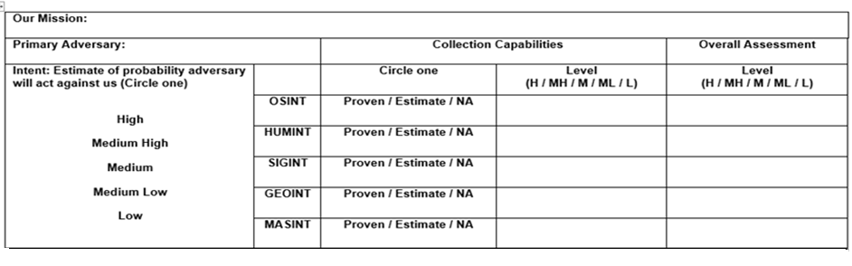
India Nuclear Test Scenario
Conduct nuclear tests
United States
High
High
High
High
High
High
High
High
High
High

Slide 21
India Nuclear Test Scenario
Vulnerability | Collection Method (OSINT, GEOINT, HUMINT, SIGINT, MASINT)
1. Activity at the testing range (Susceptible to overhead observance)
GEOINT, OSINT
2. Unsecure communications (Susceptible to SIGINT collection)
SIGINT, OSINT
3. Movement of Scientists to test site (Susceptible to human observation / interaction)
HUMINT, OSINT
4. Underground nuclear detonations (Susceptible to anomoly detection)
MASINT, GEOINT

Slide 22
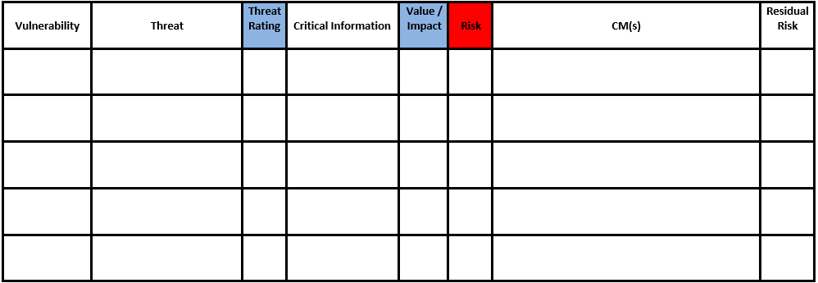
India Nuclear Test Scenario
Acceptable level of risk: Medium
Activity at testing range
GEOINT
H
Nuclear tests,
time of tests
H
H
Unsecure comms
SIGINT
H
All
H
H
Movementof scientists
H
Travel plans, time of tests
MH
MH
HUMINT/OSINT

Slide 23
India Nuclear Test Scenario
Vul. # Measure/Countermeasure MOP MOE
1 - Conduct a DISO at the missile range.
Ensure visible activity occurs at missile range not at nuclear test range, when satellites are overhead
Adversary satellites capture activity at the missile range but no indications of activity at the test range.
Activity at testing range
Unsecure comms
2 - OPSEC awareness training for all involved in
the operation, ensuring Critical Information is
not passed via non-secure means or to people
without a “need to know” to include family
Participants never discuss Critical Information with nonparticipants.
No indications of increased attention at the test range.
Movement
of
scientists
3 – Movement plan. Test personnel move using
false names on buses and trains
All personnel receive movement instructions.
No indications of increased attention at the test range.

Slide 24
India Nuclear Test Scenario
Acceptable level of risk: Medium
Activity at testing range
Nuclear tests,
time of tests
GEOINT
H
H
H
DISO
M
Unsecure comms
SIGINT
H
All
H
H
M
OPSEC awareness training
Movementof scientists
Travel plans, time of tests
Movement plan
HUMINT/OSINT
H
MH
MH
M

